Slide 1
A machine learning based approach for phishing detection using hyperlinks information
Presented By :
Asif Iqbal
Kirtiratan Sambariya
Supervisor :
Mohammad Shoaib

Slide 2
Outline
Introduction
Methodology
Feature extraction and analysis
Experimental procedures
Conclusion and future work
References

Slide 3



Introduction
Phishing is a type of Internet fraud scam where the scammer sends email messages that appear to be from financial institutions or credit card companies that try to trick recipients into giving private information (i.e., username, password, account number, etc.)

Slide 4
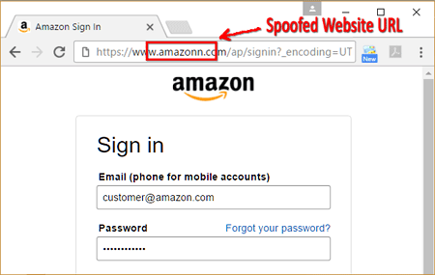
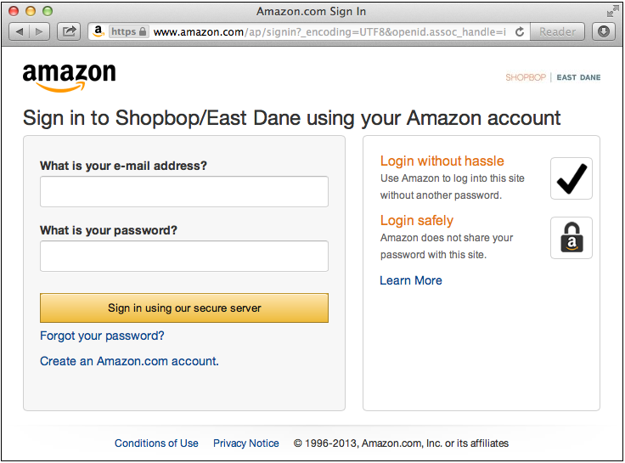
Phishing websites has same appearance as legitimate ones
Phishing Webpage
Legitimate Webpage

Slide 5


Motives
Financial gain
Damage Reputation
Identity theft
Fame and Notoriety

Slide 6
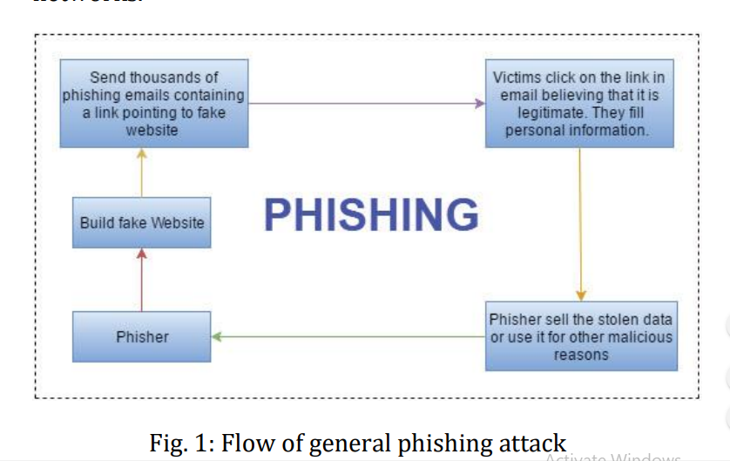
Workflow

Slide 7
Methodology
Data collection and validation
Parameter determination
Address bar based features
Abnormal based features
HTML and JavaScript based features
Domain based features
Features extraction
Algorithm selection and output classification
Pre-trained classification used to classify and predict incoming URL

Slide 8
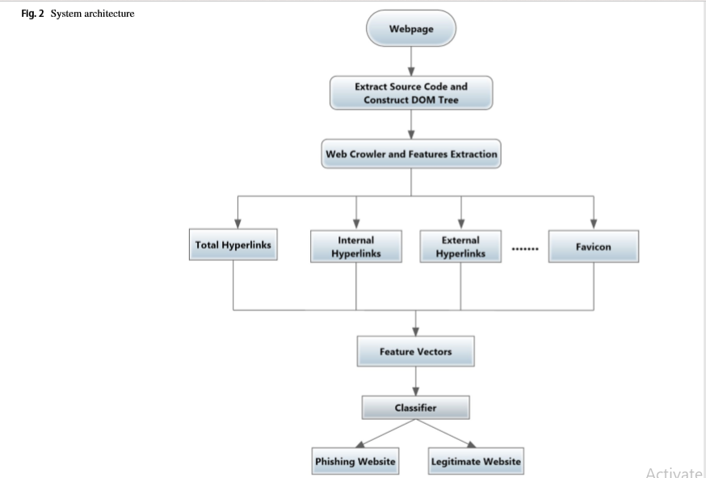
Architecture

Slide 9
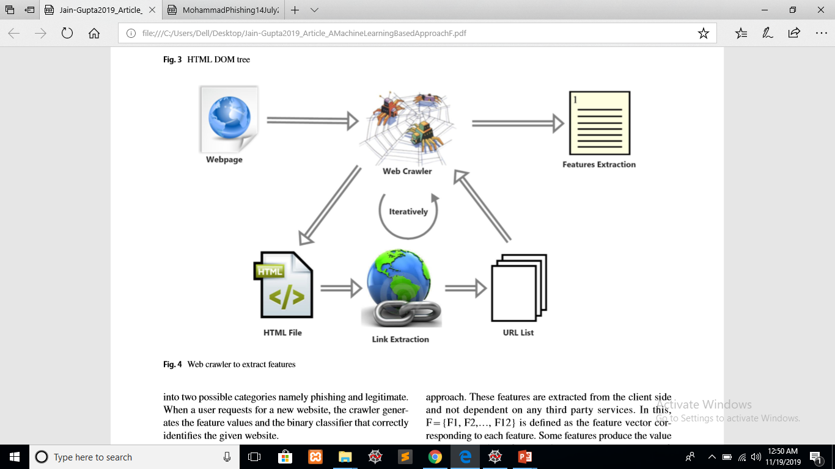
Features Extraction
Used features :
1. Using the IP Address
2. Long URL to Hide the Suspicious Part
3. Using URL Shortening Services
4. URL’s having “@” Symbol
5. Redirecting using “//”
6. Prefix or Suffix Separated by (-)
7. Sub Domain and Multi Sub Domains
8. Using Non-Standard Port
9. 9. “HTTPS” Token in the Domain Part
10. Request URL
11. URL of Anchor
12. Server Form Handler (SFH)
13. Submitting Information to Email
14. Website Forwarding
15. Website Traffic
16. Redirection

Slide 10
Model Selection
Models | Accuracy ( % )
Logistic Regression | 87.20
K-Nearest Neighbors (K-NN) | 88.30
Support Vector Machine (SVM) | 87.36
Kernel SVM | 89.15
Naïve Bayes | 57.55
Decision Tree | 90.98
Random Forest | 91.20

Slide 11
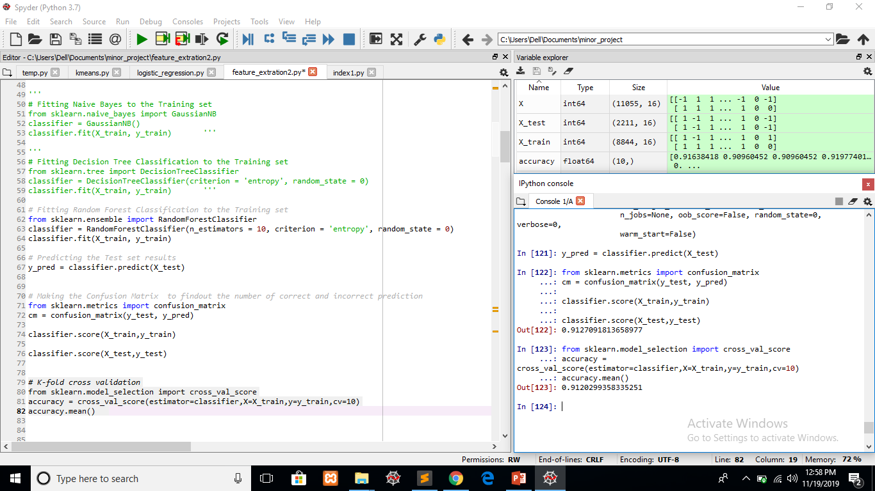
Our Model (Random Forest)

Slide 12
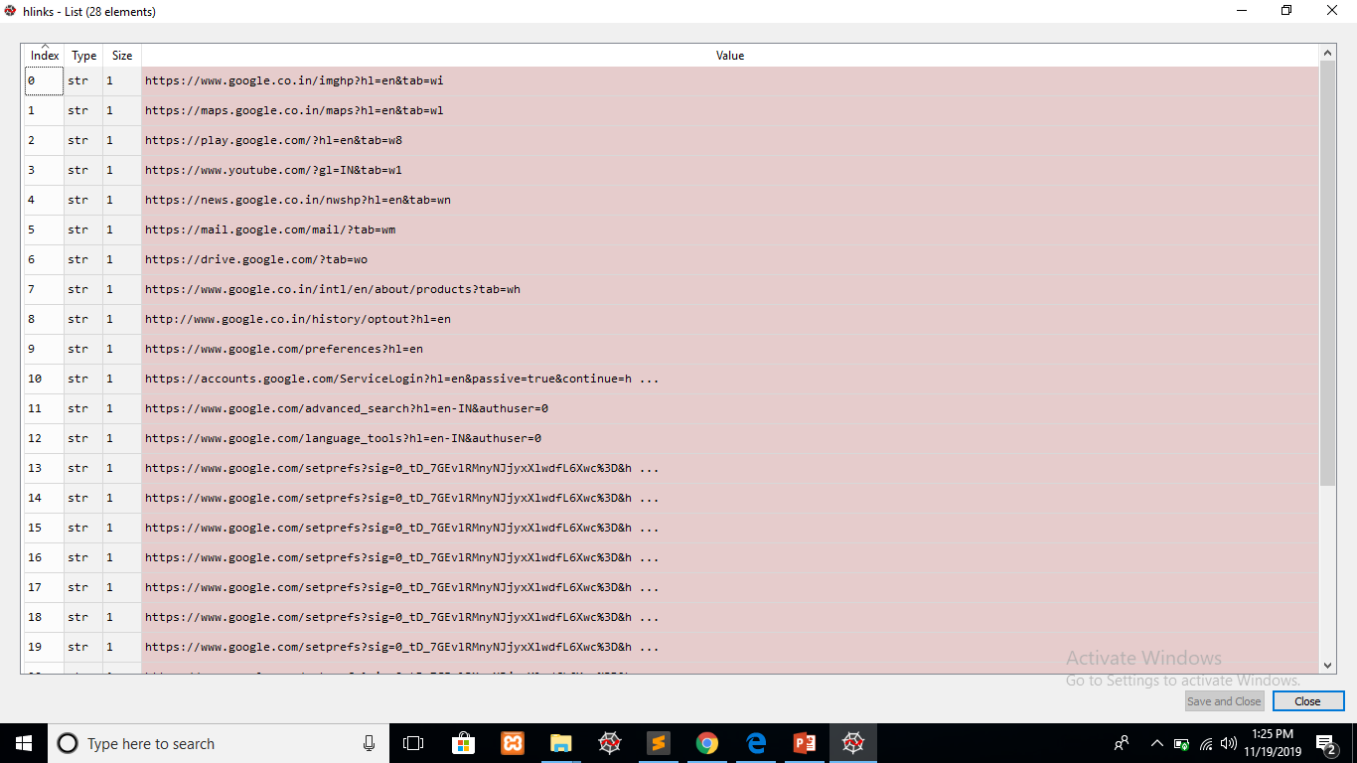
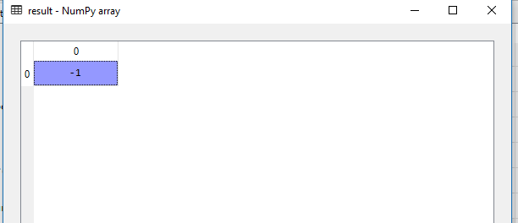
On Testing https://www.google.com

Slide 13
Conclusion and Future Work
The experimental results showed that proposed method is very efficient in classification of phishing websites as it has 91.20% overall accuracy.
The accuracy of our approach may be improved by adding certain more features
However, extracting other features from the third party will increase the running time complexity of the scheme.
Nowadays, Mobile devices are more popular and seem to be a perfect target for malicious attacks like mobile phishing. Therefore, detecting the phishing websites in the mobile environment is a challenge for further research and development.

Slide 14
References
Rami M Mohammad , Fadi Tabatah , Lee McCluskey (2014) – Phishing Websites Features - http://eprints.hud.ac.uk/id/eprint/24330/6/MohammadPhishing14July2015.pdf
Ankit Kumar Jain , BB Gupta (2018) – Machine learning approach based approach for phishing detection using hyperlinks - https://ieeexplore.ieee.org
Hemali Sampat1, Manisha Saharkar2, Ajay Pandey 3, Hezal Lopes4 - International Research Journal of Engineering and Technology (IRJET) - Detection of Phishing Website Using Machine Learning
https://www.yourdictionary.com/phishing
Udemy – Machine Learning A-Z in R and Python
Alexa top websites (2018) - https://www.alexa.com/topsites
Phishtank dataset (2018) - http://www.phishtank.com
Stackoverflow for solving raised errors – https://www.stackoverflow.com
Google images – https://www.google.com/search

Slide 15
Thanks for watching ……………

